Slide 1
GOOD MORNING
WELCOME

Slide 2
SYSTEM ASSISTANT
JARVIS

Slide 3
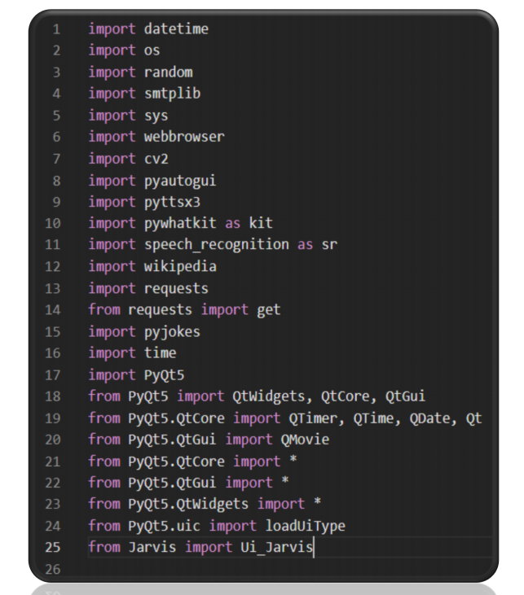
Modules and libraries

Slide 4
2.4 SOFTWARE REQUIREMENTS:
Operating System: Windows 10 [LAPTOP]
Coding Language: Python 3.9
Front End: QT Designer and PYQT5 GUI Modules
Back End: Visual Studio Code
API: News API for function
Giphy Files: Various Giphy files for Gui
Applications: Gmail, Telegram, WhatsApp, YouTube etc.

Slide 5
2.1 FUNCTIONAL REQUIREMENT:
Different Modules used for accessing different Apps and Social Media Sites.
In our GUI there is “RUN” and “TERMINATE” buttons to start and close our system assistant (Jarvis).
API, Source code Interpreter and QT designer all required for functioning of our Jarvis.
No Internet is required to access this Application.

Slide 6
JARVIS:
WISHES ACCORDING TO TIME
GIVES SATISFACTORY COMMAND IN EVERY INPUT
GIVES COMMANDS WHEN THE COMMAND IS NOT UNDESTAND OR WE ARE NOT CLEAR WITH THE WORD
ON CLOSING COMMANDS IT CLOSES THE SYSTEM AND ENDS THE CODE
JARVIS IS SET ON THE CONTINOUS LOOP TO TAKE THE TASKS AFTER EXCUTION ONE BY ONE
IT HAS AN RUN TO START THE PROGRAM AND TERMINATE BUTTON TO END IT

Slide 7
THANK YOU

